Slide 1
图像处理基础
Matlab图像处理编程实践初步
肖俊
浙江大学计算机学院
2021

Slide 2
内容提要
数字图像处理概述
Matlab图像处理基础
常用图像文件格式与类型
图像处理的基本函数
图像类型的转换
Matlab的颜色模型转换
Matlab图形的绘制
二维绘图
三维绘图

Slide 3
数字图像处理概述
数字图像处理的主要研究内容
图像变换
图像编码压缩
图像增强和复原
图像分割
图像描述
图像分析
数字图像的处理方法
空域法
领域处理
点处理
变换域法

Slide 4
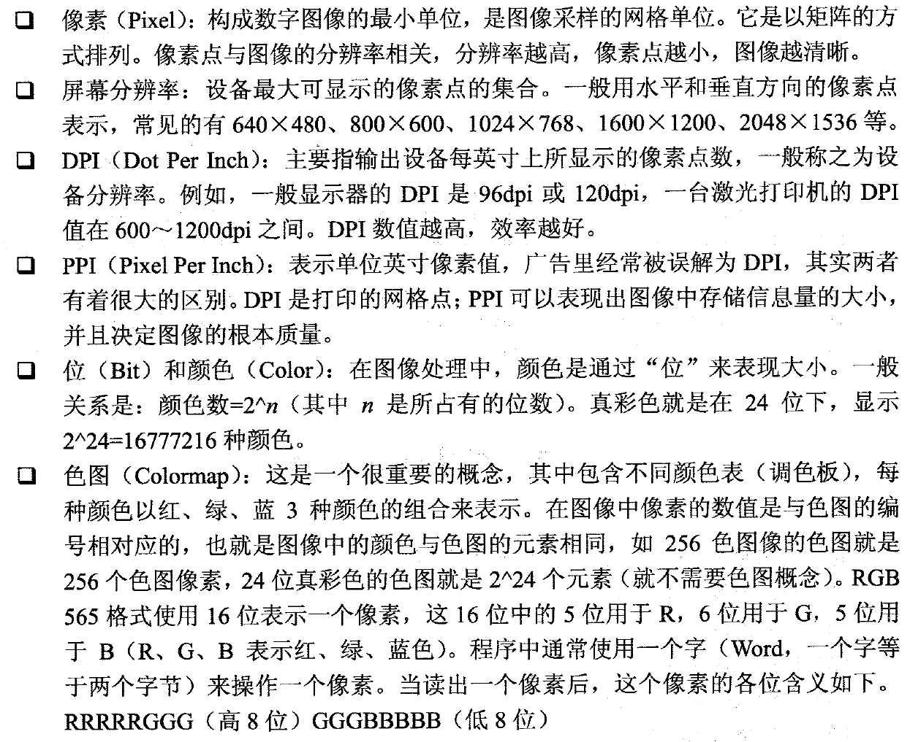
数字图像处理概述
图像术语

Slide 5
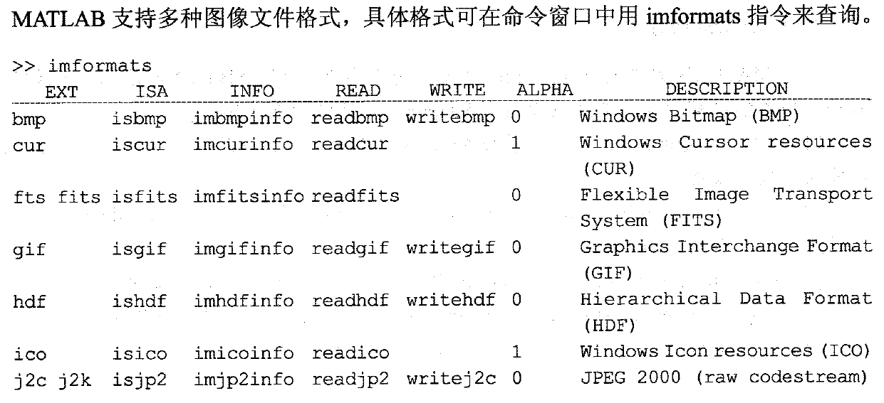
Matlab图像处理基础——文件格式与类型
图像文件格式

Slide 6
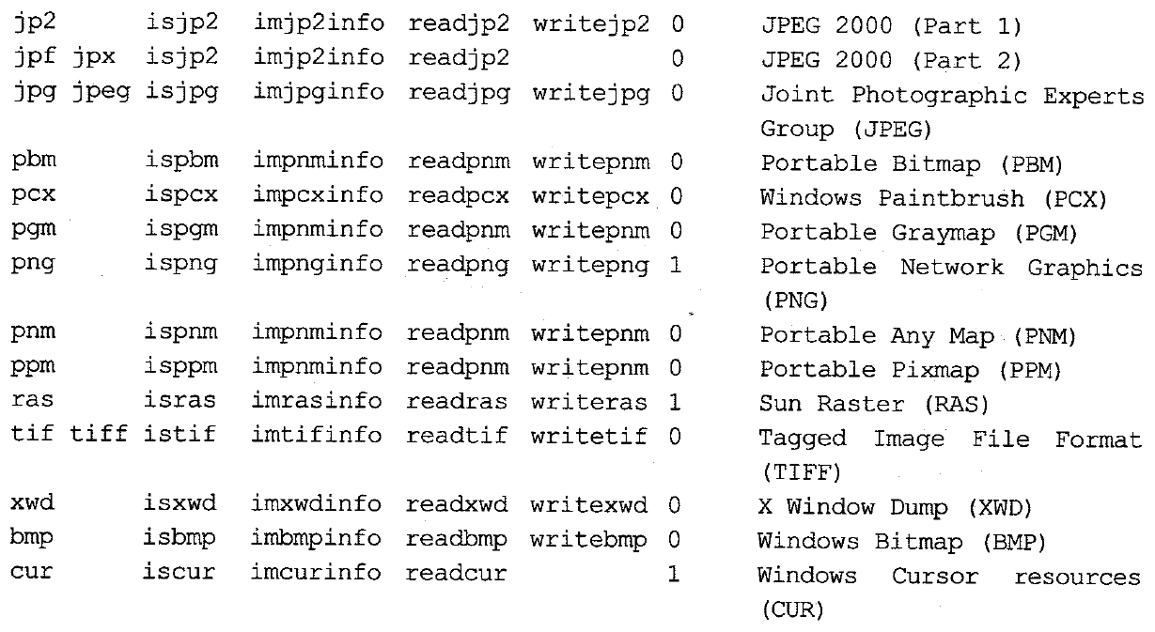
Matlab图像处理基础——文件格式与类型

Slide 7
Matlab图像处理基础——文件格式与类型
图像类型
二值图像
灰度图像
索引图像
RGB图像

Slide 8
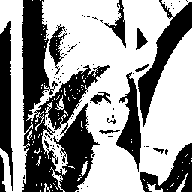
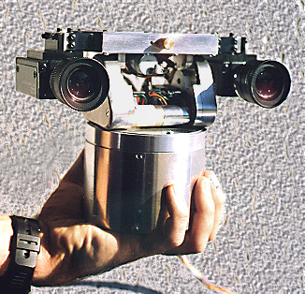
Matlab图像处理基础——文件格式与类型
二值图像：1-Bit Image
1-Bit Image Examples

Slide 9
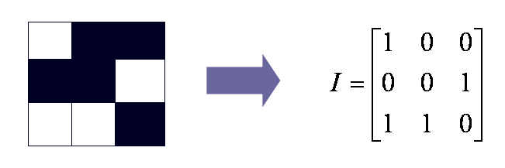
Matlab图像处理基础——文件格式与类型
Consist of on and off pixels (pixel--picture elements in digital images)
Each pixel is stored as a single bit (0 or 1), 0--black, 1--white

Slide 10
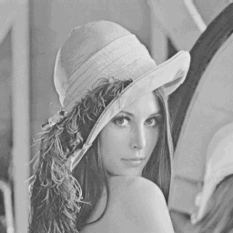
Matlab图像处理基础——文件格式与类型
灰度图像
8-Bit Gray-Level Image Examples

Slide 11
Matlab图像处理基础——文件格式与类型
8-Bit Gray-Level Image VS 1-Bit Image

Slide 12
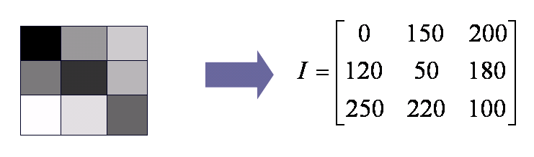
Matlab图像处理基础——文件格式与类型
Each pixel is represented by a single byte
A gray value between 0 and 255
The entire image can be thought of as a two-dimensional array of pixel values
Called bitmap

Slide 13
1.2 8-Bit Gray-level Image：Print
How to print an 8-bit gray-level image on 2-level (1-bit) printer?
DPI
Dot per inch
Printing such image is complex
Use Dithering
Convert intensity resolution into spatial resolution

Slide 14
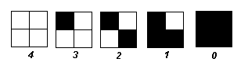
1.2 8-Bit Gray-level Image：Print
Dithering
The main strategy is to replace a pixel value by a larger pattern, say 2 x 2 or 4 x 4, such that the number of printed dots approximates the varying-sized disks of ink used in analog, in halftone printing (e.g., for newspaper photos).
Convert the color resolution into the spatial resolution.
An N×N matrix represents N²+1 levels of intensity
2×2 pattern can represent five level：

Slide 15
1.2 8-Bit Gray-level Image：print
we can first re-map image values in 0..255 into the new range 0..4 by (integer) dividing by 256/5. Then, e.g., if the pixel value is 0 we print nothing, in a 2×2 area of printer output. But if the pixel value is 4 we print all four dots.
If the intensity is > the dither matrix entry then print an on dot at that entry location: replace each pixel by an n x n matrix of dots.
The above method increasing the size of the output image
If one pixel uses 4×4 pattern，the size of an N×N image becomes 4N×4N，makes an image 16 times as large!

Slide 16
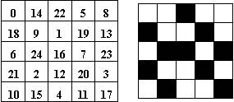
1.2 8-Bit Gray-level Image：print
One better method：Avoid enlarging the output image
Store an integer matrix (Standard Pattern), each value from 0 to 255
Comparing the grey image matrix with pattern, print the dot when the value greater than the grey
One 25-grey level case: left is standard, the right with grey=15

Slide 17
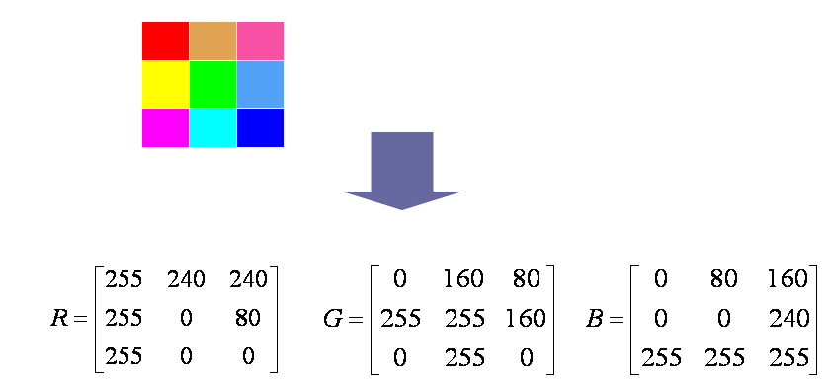
Matlab图像处理基础——文件格式与类型
RGB图像
Each pixel using three bytes: representing RGB
Value from 0 to 255；
Supports 256×256×256 colors，16,777,216
Each pixel described by different grey values of RGB

Slide 18
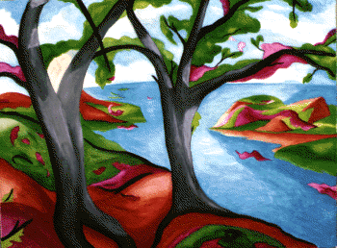
Matlab图像处理基础——文件格式与类型
索引图像——8位彩色图像

Slide 19
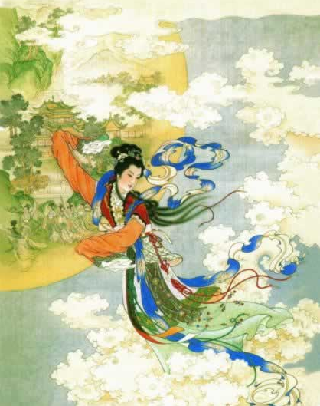
Matlab图像处理基础——文件格式与类型
8-Bit Color Image VS 24-Bit Color Image

Slide 20
Matlab图像处理基础——文件格式与类型
The idea of using Lookup table( palette)
An image store a set of bytes，not the real color
Bytes value is the index to a 3-bytes color table
Choosing what colors to put in table is important
Choose the most important 256 colors
Generated by clustering the 256×256×256 colors
Median-cut Algorithm
More accurate version of the Median-cut Algorithm

Slide 21
Matlab图像处理基础——文件格式与类型
The idea used in 8-bit color images is to store only the index, or code value, for each pixel. Then, e.g., if a pixel stores the value 25, the meaning is to go to row 25 in a color look-up table (LUT).
Value as the Index to Table
Get the color values by Searching
The RGB value of the pixel

Slide 22
1.6 How to Devise a Color Lookup Table
Example: 8-Bit Color Image
Humans are more sensitive to R and G than to B
So R=3, G=3 and B=2
Basic Idea —— Clustering
Analyzing the three-dimensional histogram of RGB colors
Clustering is an expensive
and slow process
R | R | R | G | G | G | B | B

Slide 23
1.6 How to Devise a Color Lookup Table

Slide 24
1.6 How to Devise a Color Lookup Table
Then each pixel in the image gets replaced by its 8-bit index.
Eg.
R: 16, 48, 80, 112, 144, 176, 208, 240
G: 16, 48, 80, 112, 144, 176, 208, 240
B: 32, 96, 160, 224
A pixel with color [30, 129, 80] should be converted into:
[16, 112, 96]

Slide 25
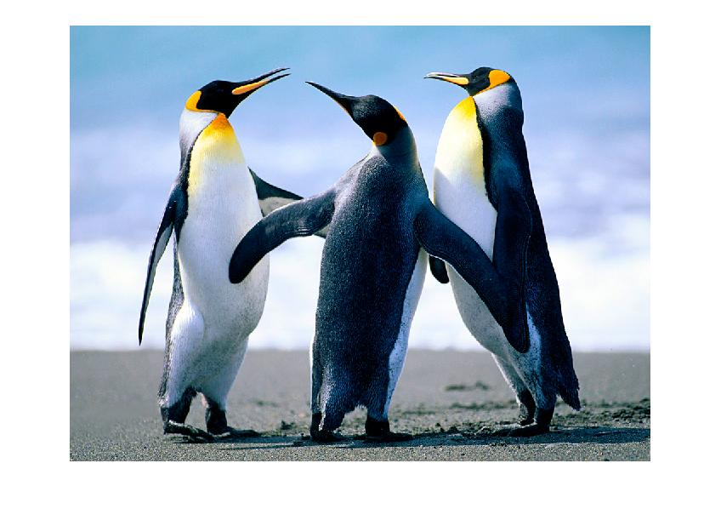
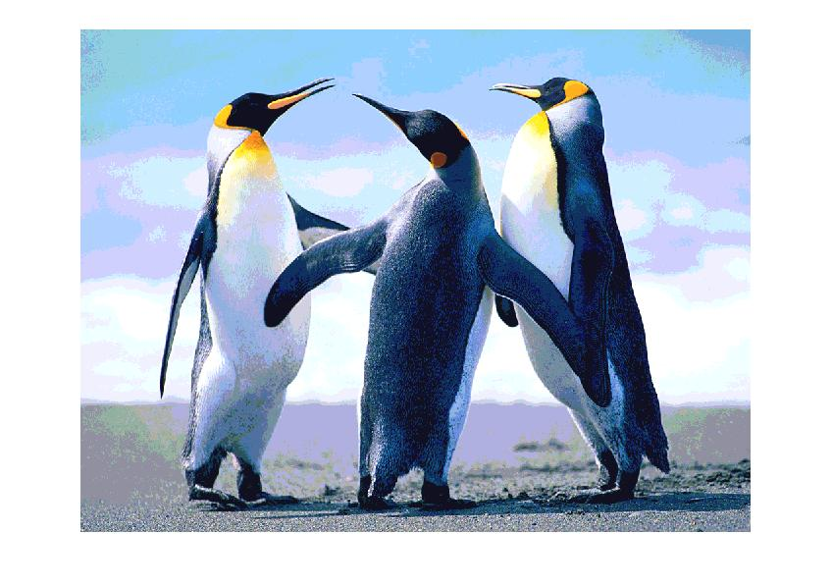
1.6 How to Devise a Color Lookup Table

Slide 26
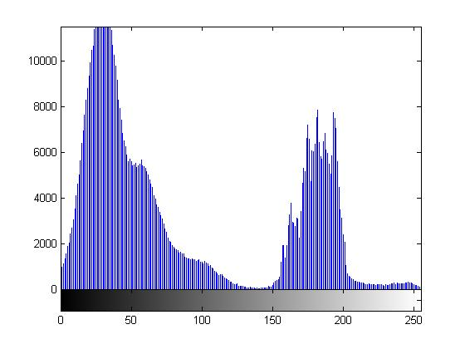
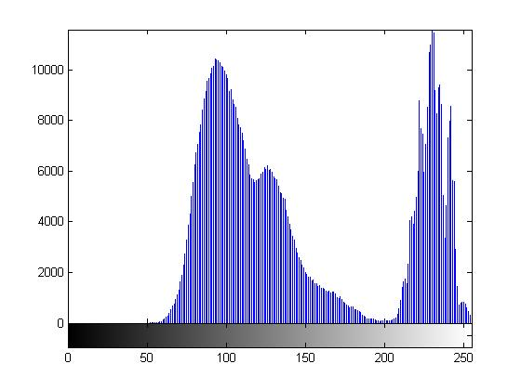
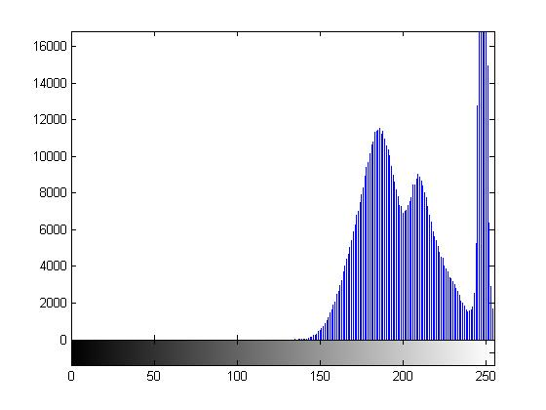
1.6 How to Devise a Color Lookup Table
Can we achieve better result?

Slide 27
1.6 How to Devise a Color Lookup Table

Slide 28
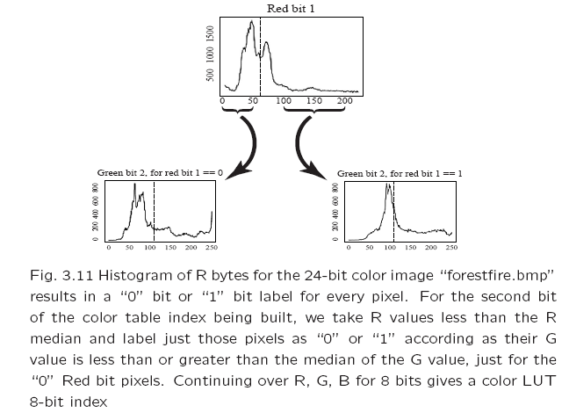
1.6 How to Devise a Color Lookup Table

Slide 29
1.6 How to Devise a Color Lookup Table
Median-cut Algorithm
R
0 | 1
G
00 | 01 | 10 | 11
B
000 | 001 | 010 | 011 | 100 | 101 | 110 | 111
…
…
…

Slide 30
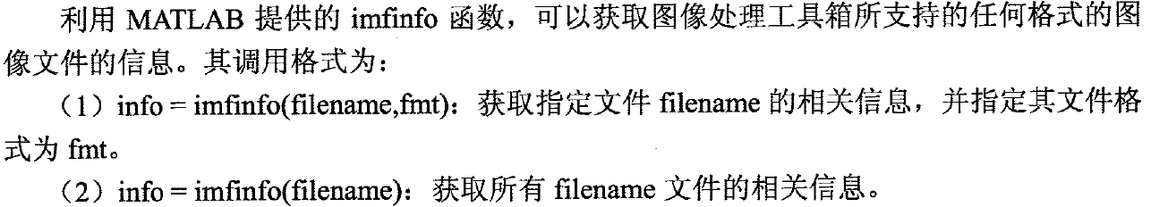
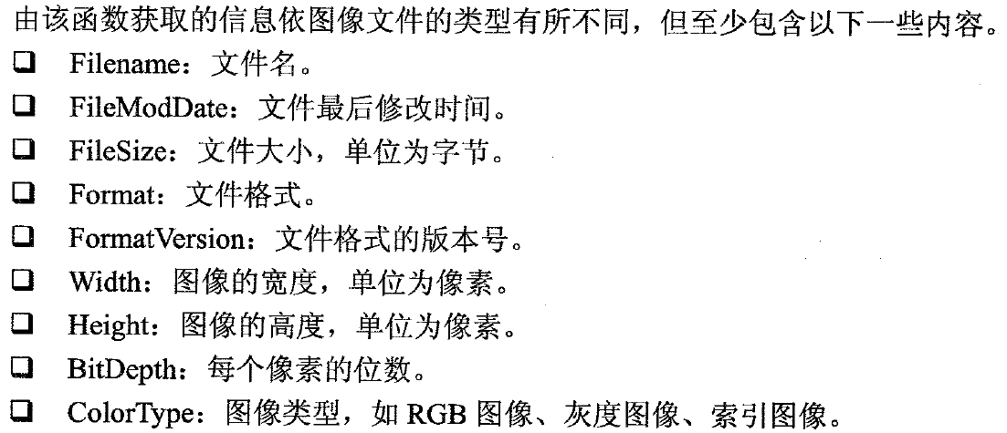
Matlab图像处理基础——图像处理基本函数
文件查询与读取

Slide 31
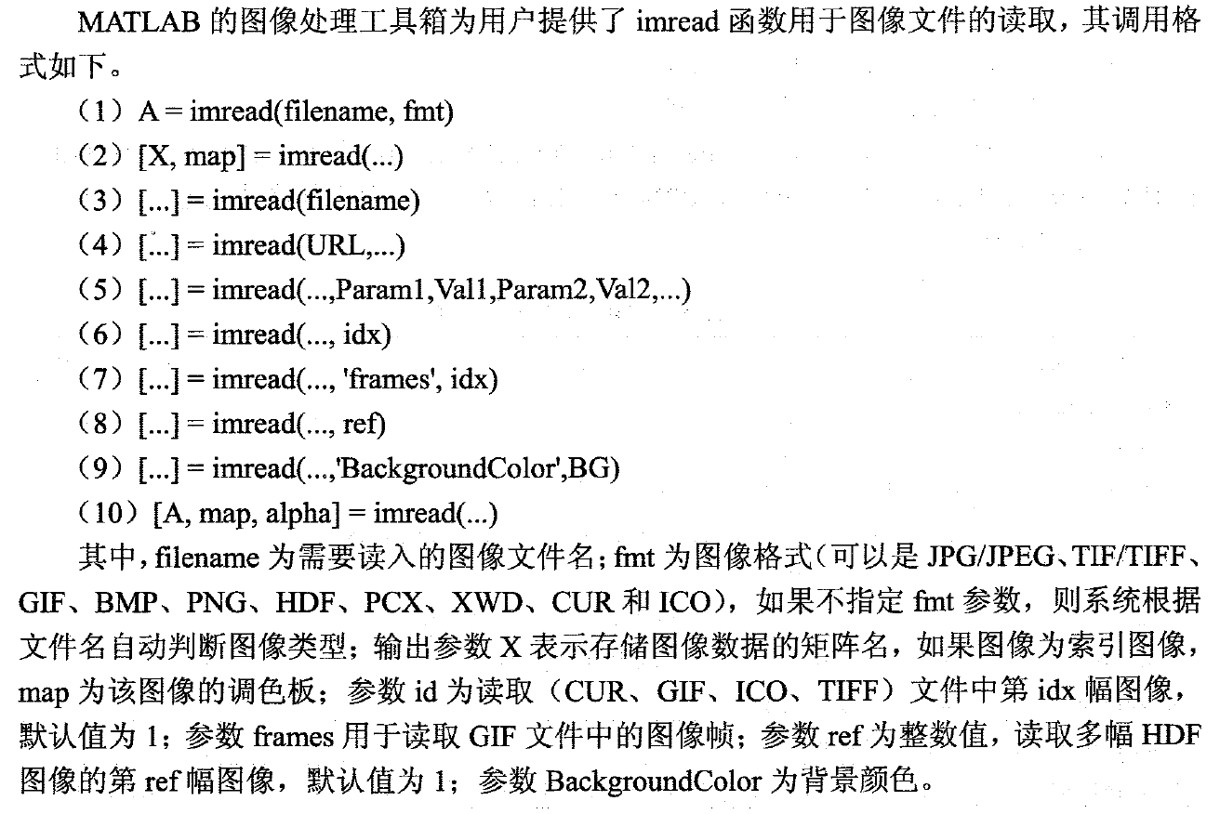
Matlab图像处理基础——图像处理基本函数

Slide 32
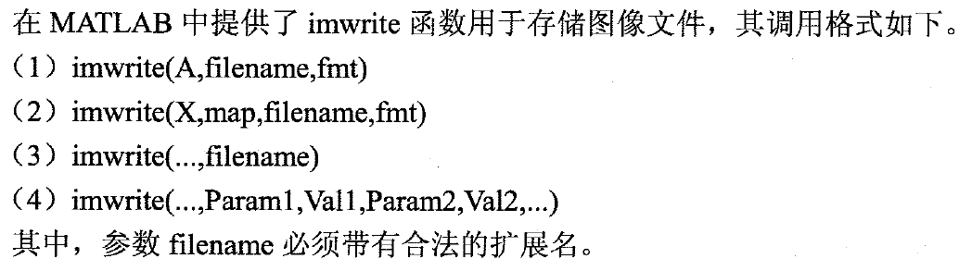
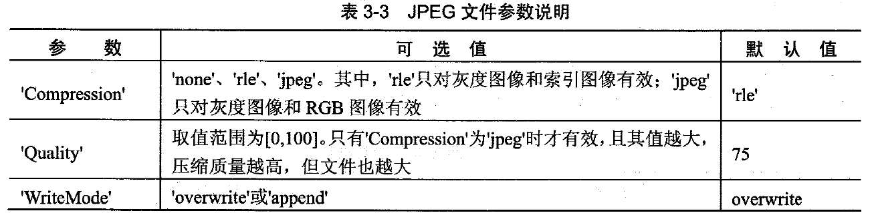
Matlab图像处理基础——图像处理基本函数
图像文件写入

Slide 33
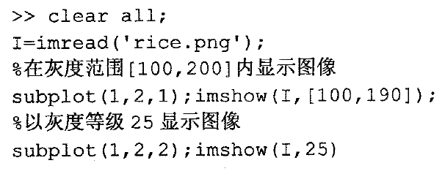
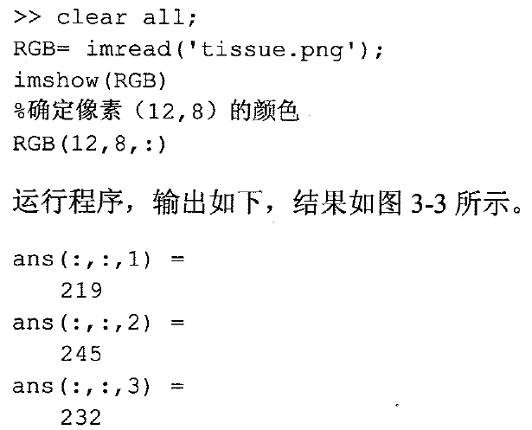
Matlab图像处理基础——图像处理基本函数
图像显示
imshow finename;
imshow(BW);
imshow(X,MAP);
imshow(I)
imshow(RGB)

Slide 34
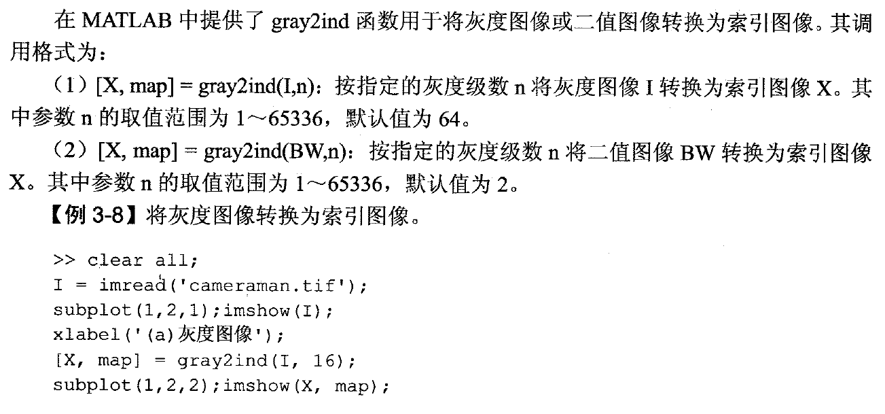
Matlab图像处理基础——图像类型转换

Slide 35
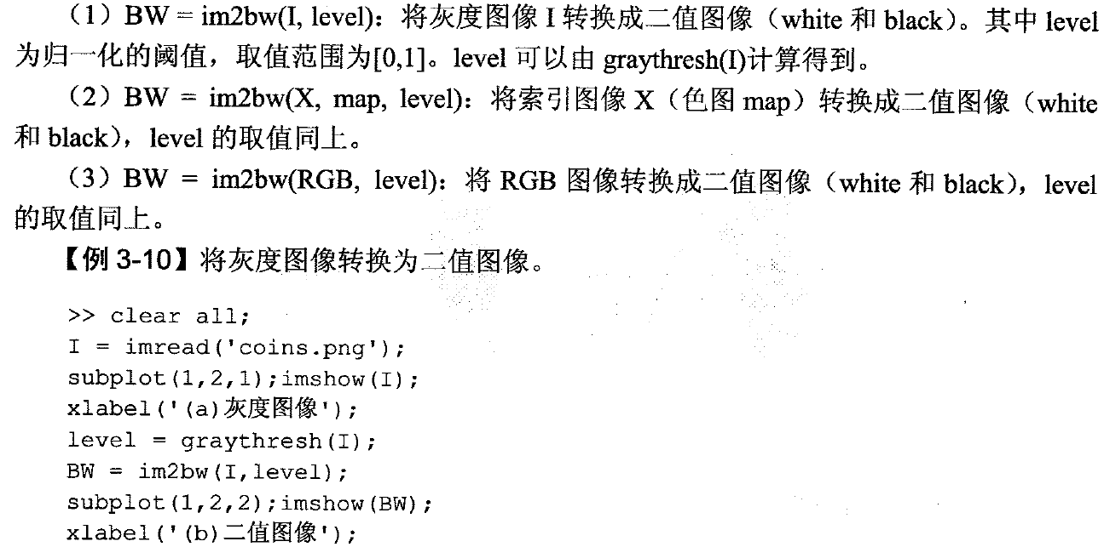
Matlab图像处理基础——图像类型转换

Slide 36
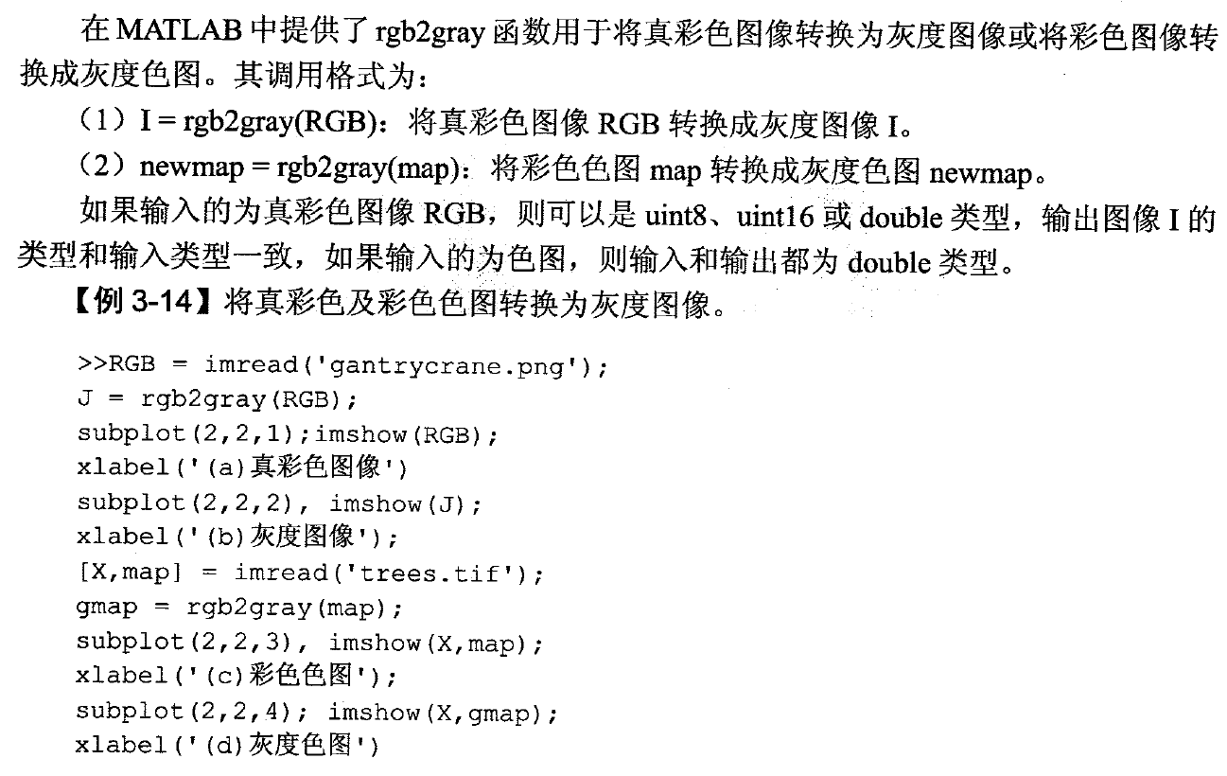
Matlab图像处理基础——图像类型转换

Slide 37
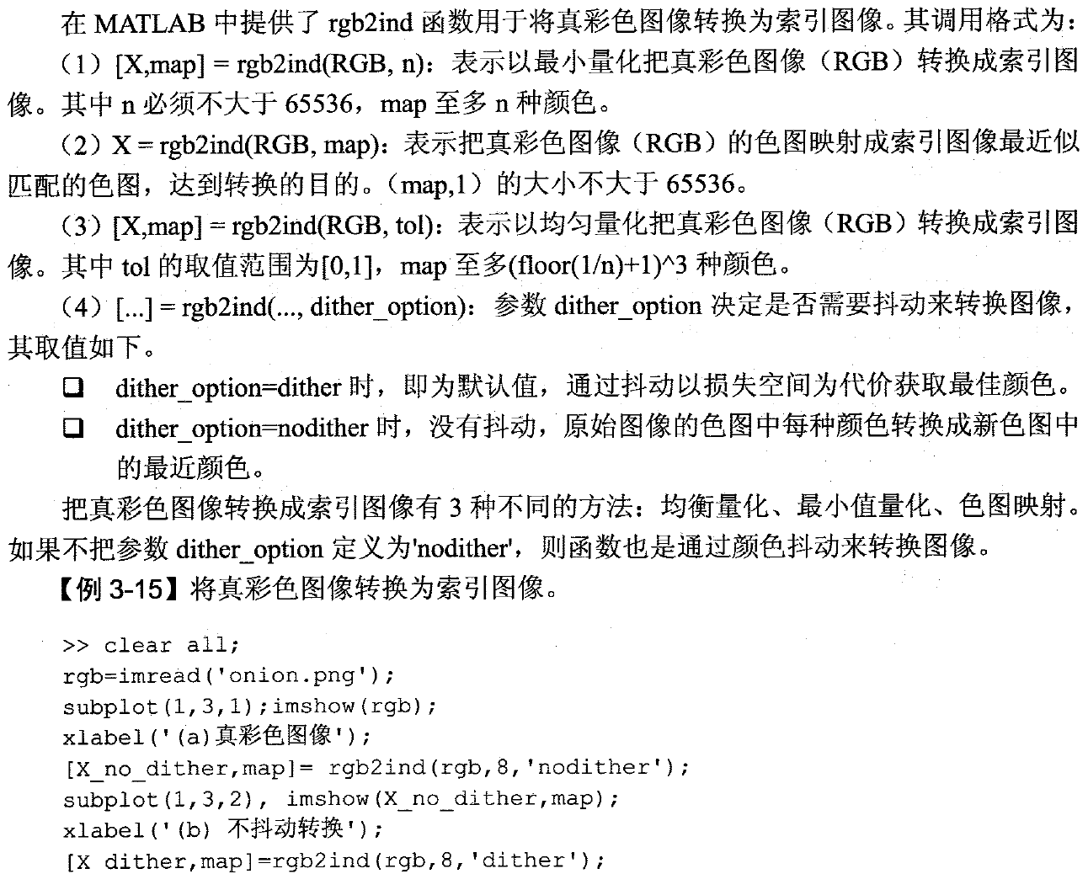
Matlab图像处理基础——图像类型转换

Slide 38
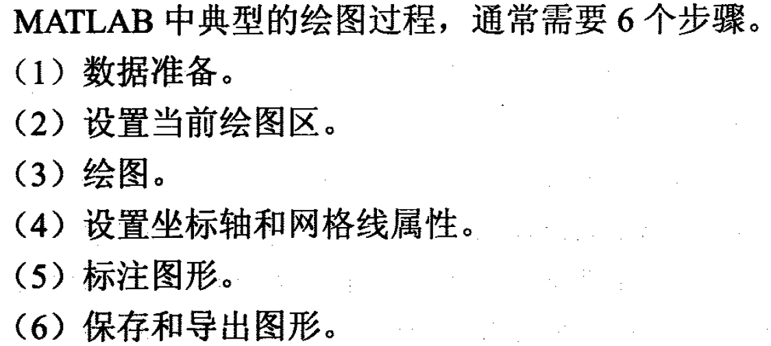
Matlab图形绘制——二维绘图
基本步骤

Slide 39
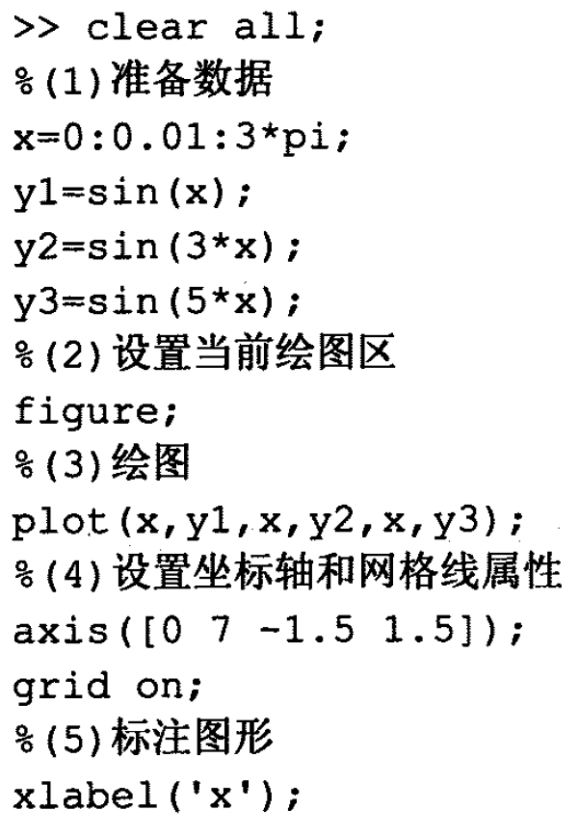
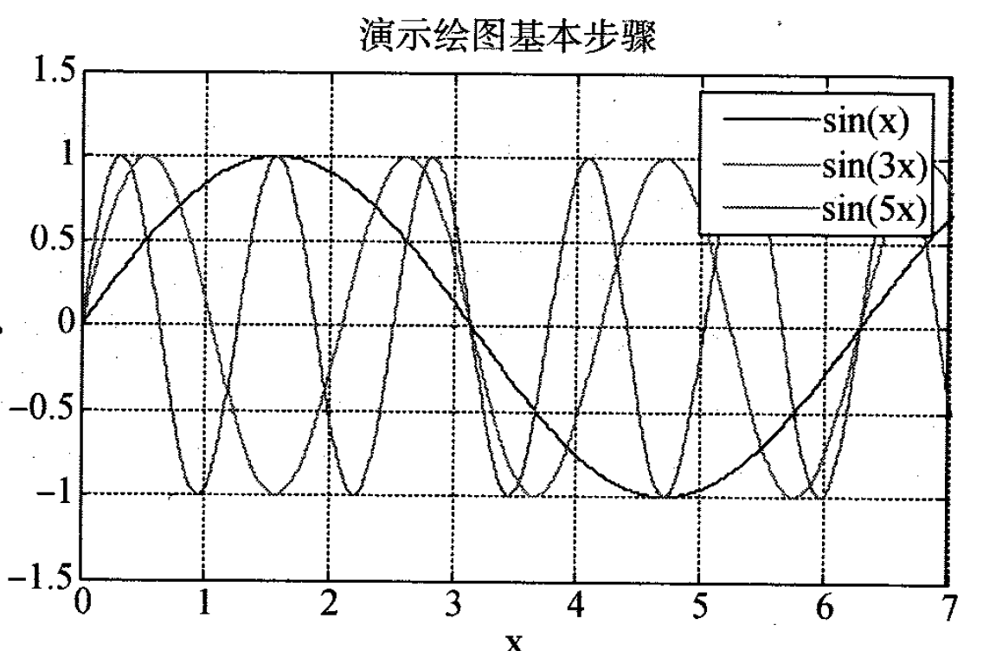
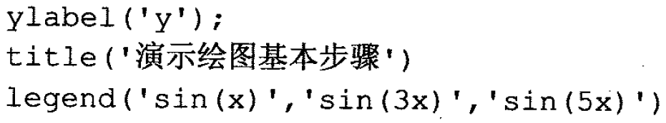
Matlab图形绘制——二维绘图

Slide 40
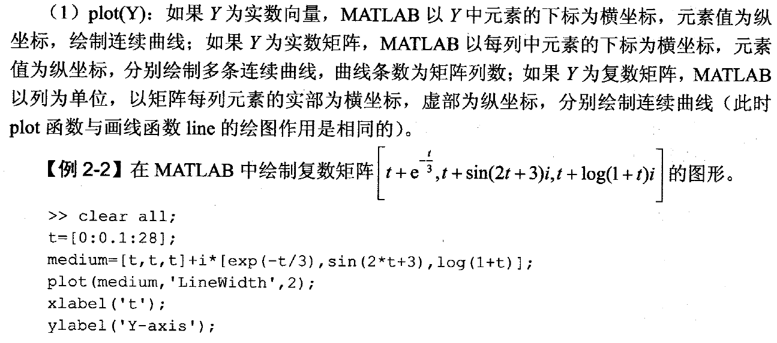
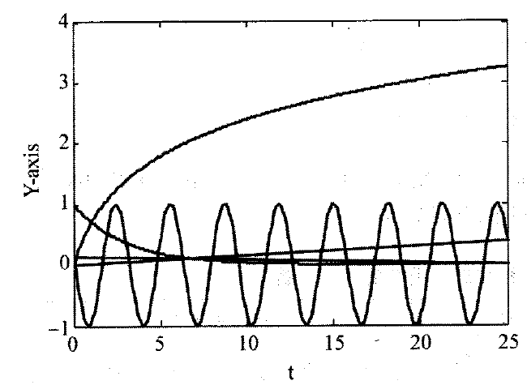
Matlab图形绘制——二维绘图

Slide 41
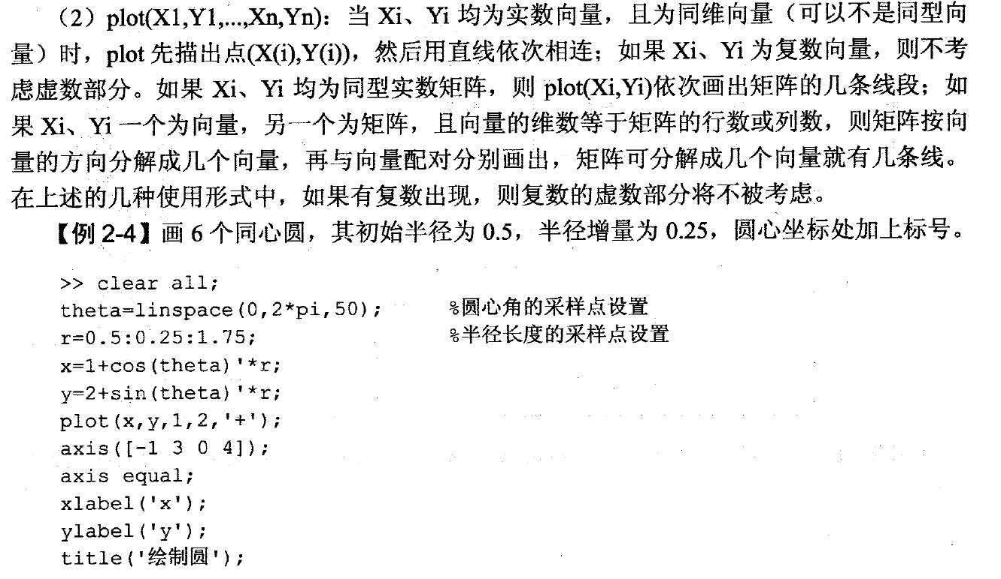
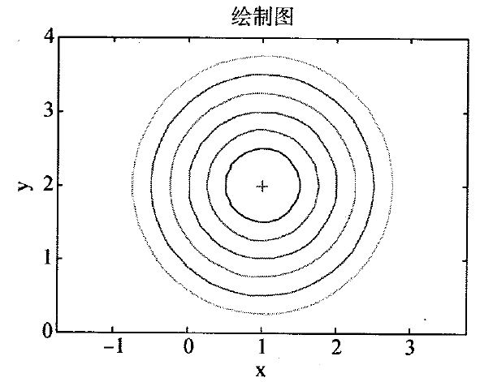
Matlab图形绘制——二维绘图

Slide 42
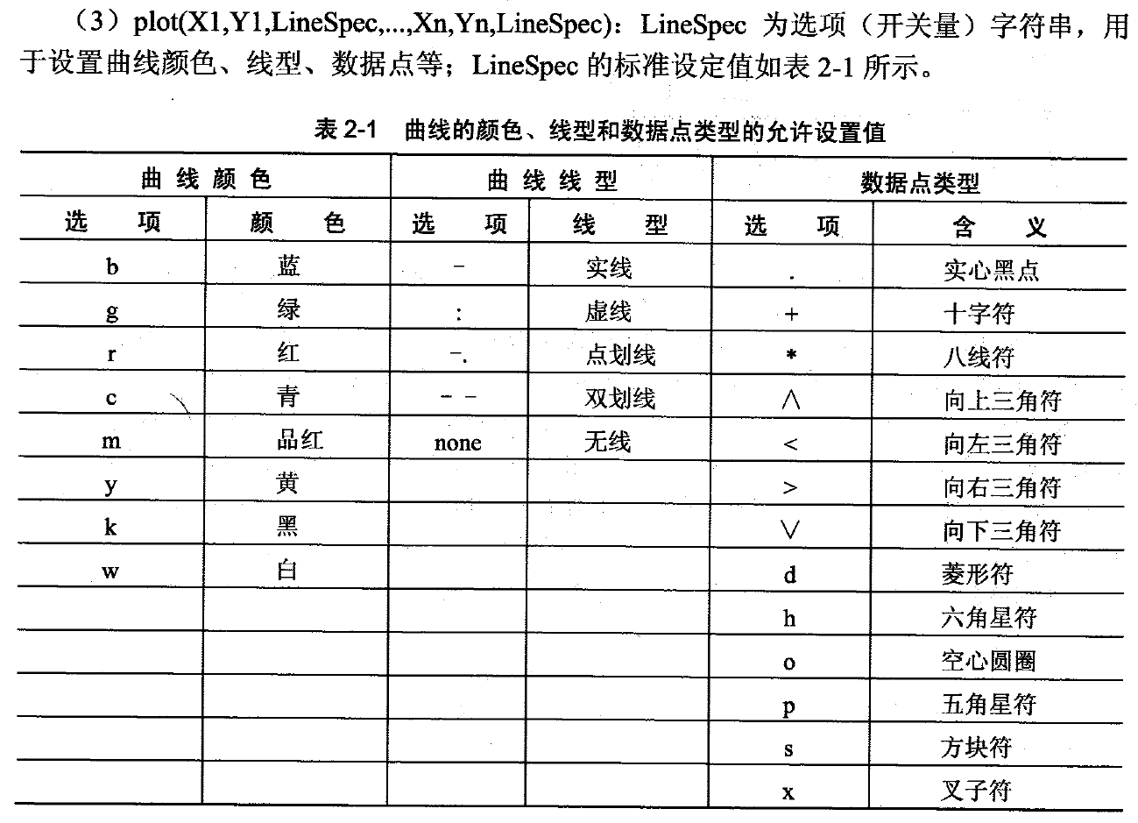
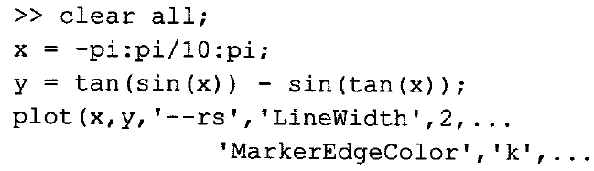
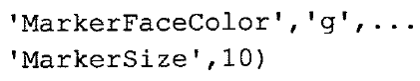
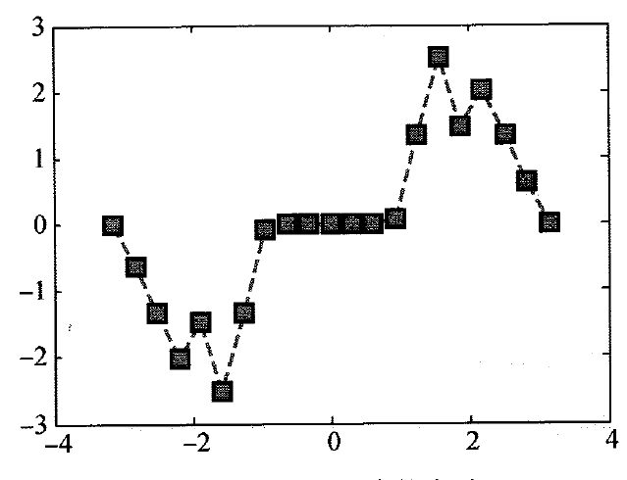
Matlab图形绘制——二维绘图

Slide 43
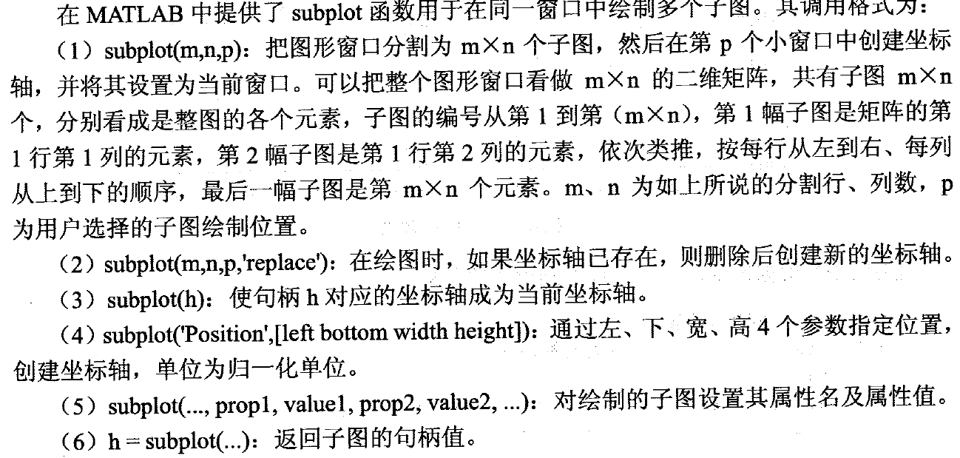
Matlab图形绘制——二维绘图
绘制子图

Slide 44
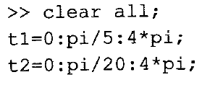
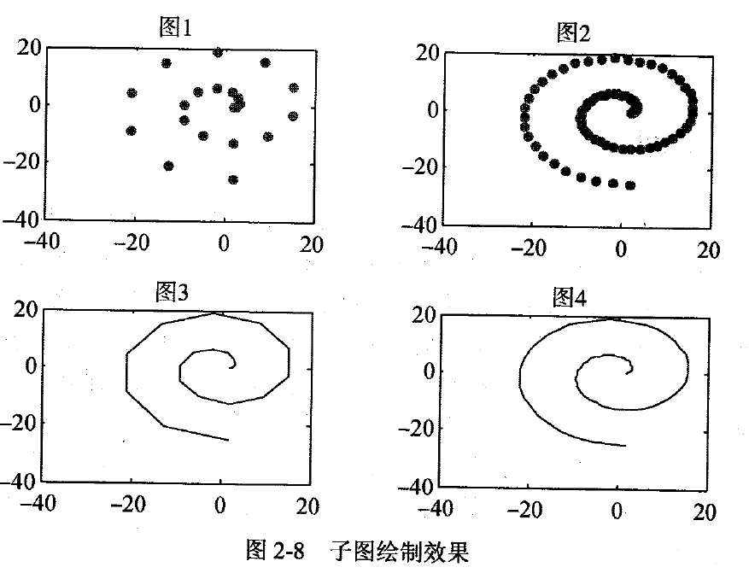
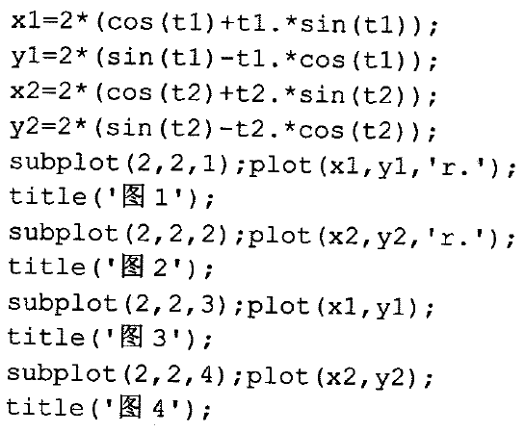
Matlab图形绘制——二维绘图

Slide 45
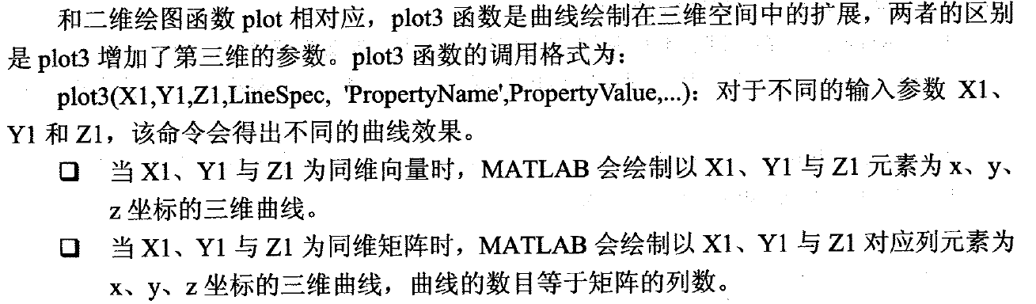
Matlab图形绘制——三维绘图
基本三维绘图

Slide 46
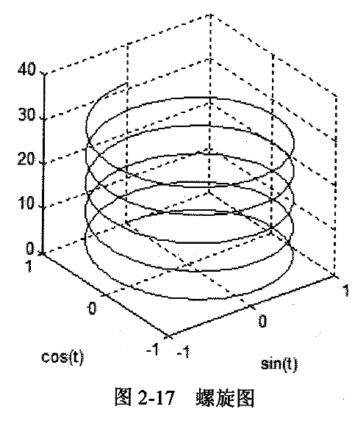
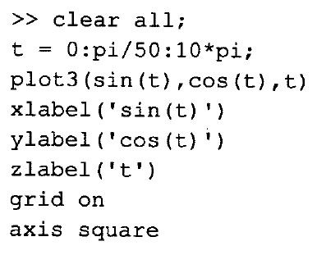
Matlab图形绘制——三维绘图

Slide 47
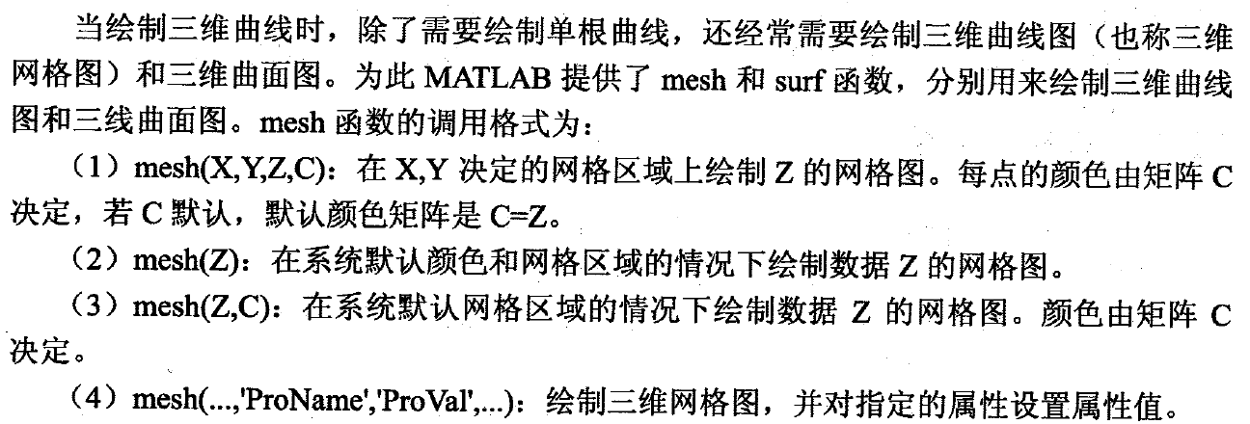
Matlab图形绘制——三维绘图
三维曲线图

Slide 48



Matlab图形绘制——三维绘图

Slide 49

Matlab图形绘制——三维绘图
三维曲面图

Slide 50


Matlab图形绘制——三维绘图

Slide 51
课程实验2
编写matlab脚本实现如下功能：
（1）读入一张真彩色图像；
（2）编写matlab函数实现真彩色-》灰度图像的转换并调用输出结果，保存为新图像文件；
（3）编写matlab函数统计一张灰度图像中每一个像素值的数量并输出二维统计图形。
（4）编写matlab函数实现真彩色-》二值图像的转换并调用输出结果，保存为新图像文件；
（5）编写matlab函数统计一张二值图像中的0/1像素数量并输出二维统计图形；
备注：不准调用matlab中与上述功能相关的自有函数。
在实验课上完成，请助教检查并记录。

